Slide 1





Eco-Schools
Notes:
This year our school is going to be part of something very exciting: Eco-Schools!
Has anyone ever heard of the Eco-Schools programme?
Eco-Schools is a charity that encourages pupils like you to protect the environment and make the world a much nicer place to live in.
What do you think environment means?
The environment is everything surrounding you – where you live, work and play! This year our school is going to improve our environment for the benefit of all things living now and in the future!

Slide 2
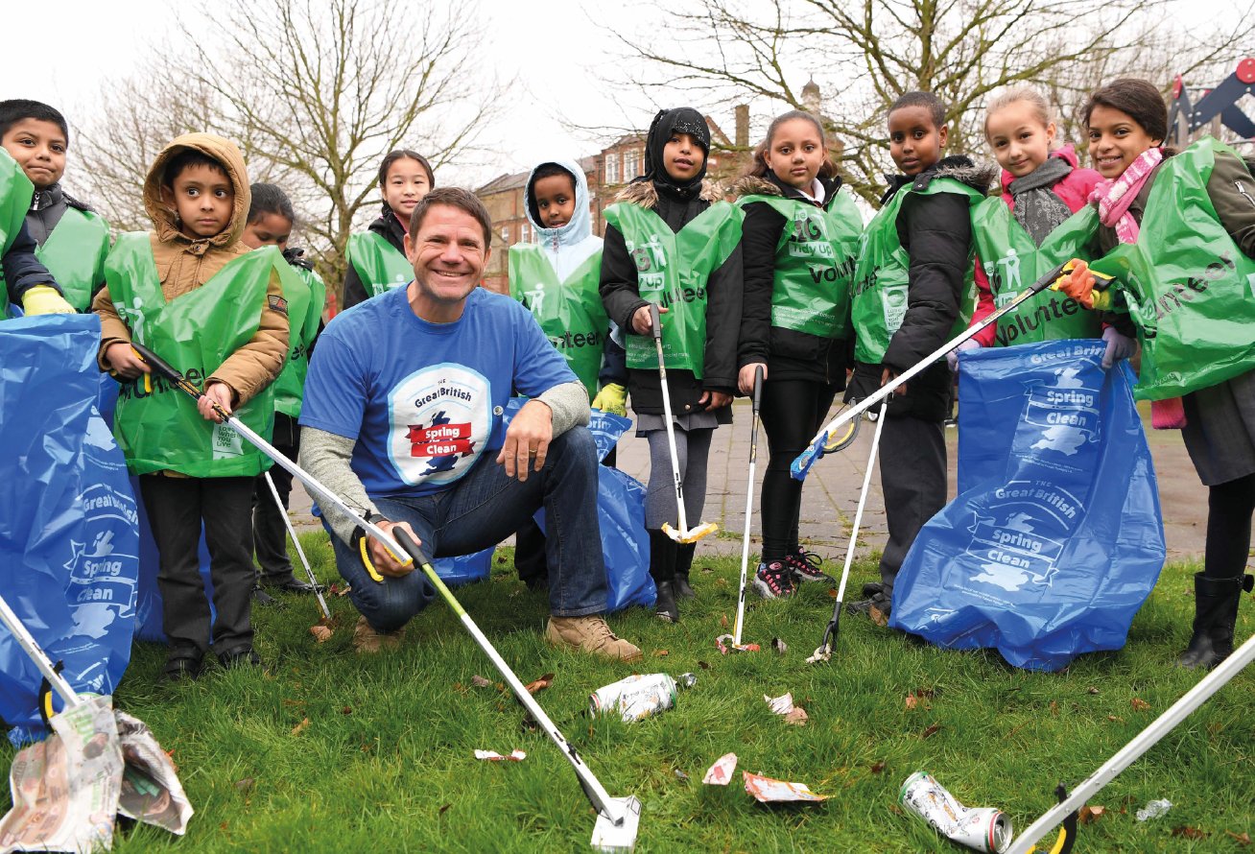
Notes:
Why do you think it is important that we become an Eco-School?
Because we have to live in this world, so we should take responsibility for looking after it. If we become an Eco-School we can save the world, make our school a nicer place to work, save money and prove to everyone that children care about the world we live in!

Slide 3

Does anyone recognise this logo?
Notes:
Do any of you recognise this logo?
This is Tidy Man- because in England Eco-Schools is run by the environmental charity Keep Britain Tidy. Keep Britain Tidy has been responsible for Eco-Schools in England for 25 years. You might recognise this logo – it’s on everything from bins to chocolate bars!

Slide 4
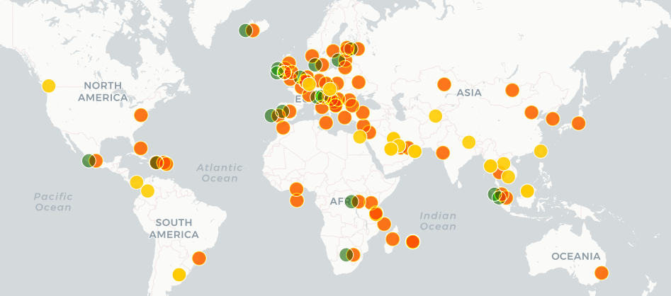
There are Eco-Schools all around the world.
Notes:
There are Eco-Schools all around the world in nearly 70 different countries including Iceland, Brazil, Madagascar and Japan. In fact, as of today our school is now a part of the largest educational programme on the planet and you are joining 19.5 million other students working to protect the world we live in.

Slide 5










Eco-Schools has ten topics that we can choose to work on.
Can you guess what they are?
Notes:
From left to right top to bottom:
Biodiversity: This includes every living thing on the planet including all plants, animals and insects.
Energy – We use energy everyday in school and at home, but do we waste energy and does the energy we use harm our planet?
Global Citizenship – This means behaving responsibly towards our planet and everyone that lives in it.
Healthy Living – As well as looking after the planet, it is also important to look after our physical and mental wellbeing.
Litter – Litter looks terrible, damages the environment and harms wildlife.
Marine – This is any area of natural water. Our marine life is more at risk now than ever before.
School Grounds – It is important that we work and play in a nice, local environment.
Transport – The way you travel to school could harm the environment and effect your and other’s health.
Waste – Waste is everything we discard because it is no longer useful.
Water – In England we have plenty of clean water, but others around the world are not so fortunate.
What topic would you most like to work on and why?

Slide 6

Notes:
All 52,000 Eco-Schools follow the same, simple Seven Step process in order to achieve an international Green Flag award.
Step 1 is to form an Eco-Committee: Our Eco-Committee will meet regularly to discuss environmental issues and plan actions to tackle these issues – we need to make sure it has at least one person from every year group in it.
Step 2 is completing an Environmental Review: The Eco-Committee will check the impact our school is having on the environment.
Step 3 is creating an Action Plan: When the Eco-Committee have completed the Environmental Review, they will decide which of the ten Eco-Schools topics they want to work on. They will then decide what actions they want to take for each topic.
Step 4 is Linking to the Curriculum: Throughout the year each class will be learning about environmental issues. If you think your class has worked on one of the Eco-Schools ten topics you need to let the Eco-Committee know.
Step 5 is making sure the whole school and school community are Informed of and Involved in what is going on: Throughout the year the Eco-Committee will keep you up-to-date on what they are doing – they will also make sure the whole school benefits and is involved in the actions they plan. Remember to check out the Eco-Board for updates and if you have any great environmental ideas let the Eco-Committee know!
Step 6 is Monitoring and Evaluating the eco-actions: an important part of Eco-Schools is checking whether our environmental actions have made a difference – it is up to the Eco-Committee to check their actions are succeeding and make changes if they’re not.
Step 7: Eco-Code: At the end of it all we will need to create an Eco-Code that demonstrates how our school cares for the environment.

Slide 7
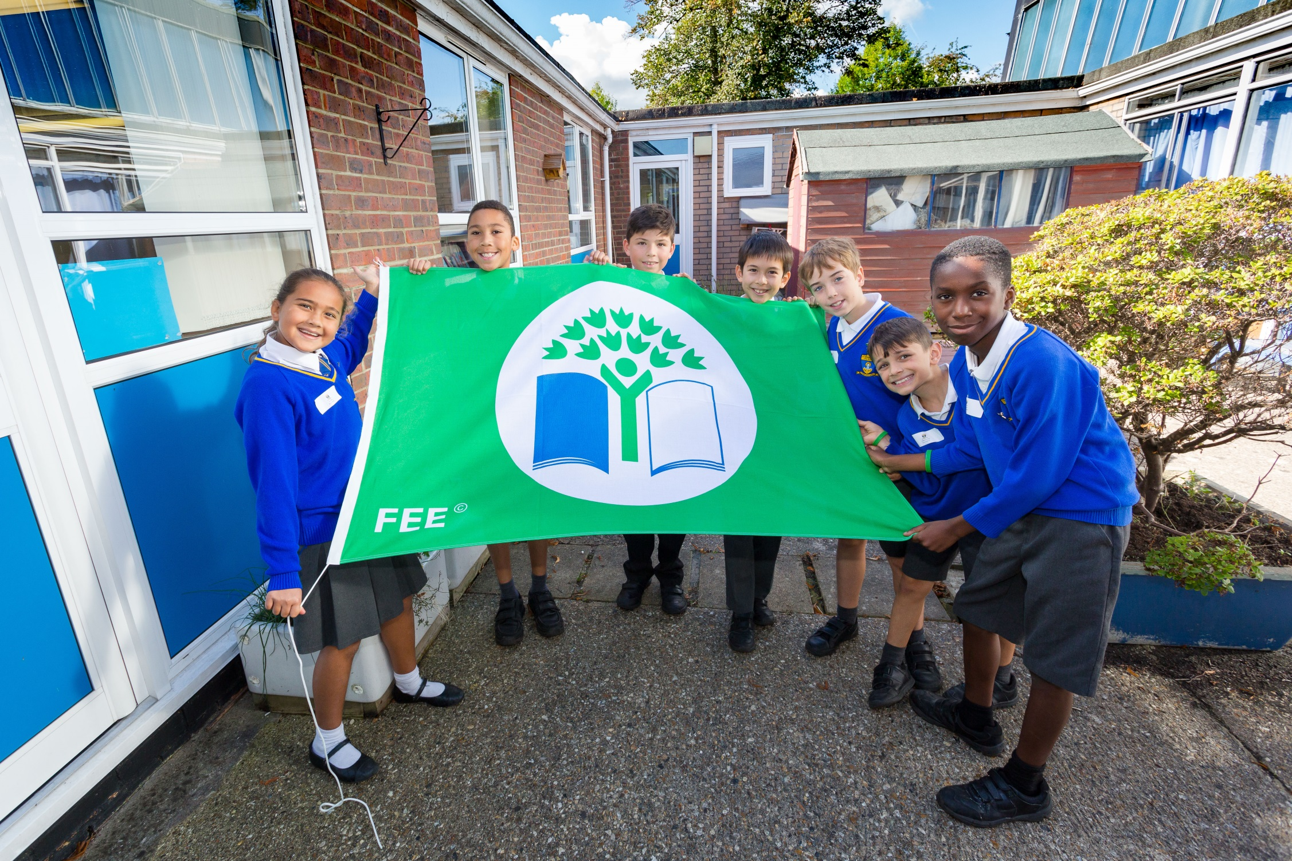
Notes:
When our Eco-Committee complete their Eco-Actions our school will be visited by a Green Flag Assessor. Their job is to check whether our school deserves to be awarded an International Green Flag. If we are successful we can display this award to show the whole world how much we care for the planet we live on.

Slide 8
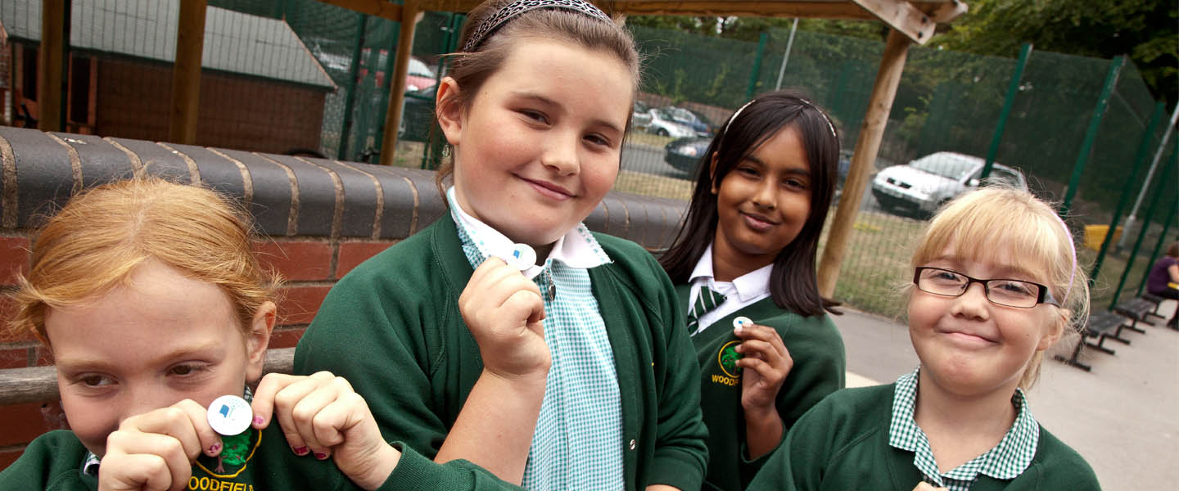
What do we need to do next?
Notes:
Who remembers what our first step is?
To form an Eco-Committee!
Stand up or put your hand up if you would like to be considered for our school’s Eco-Committee.

