Slide 1
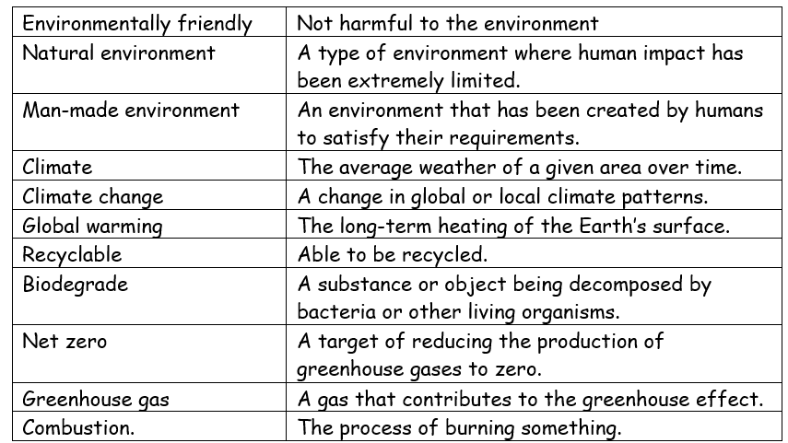
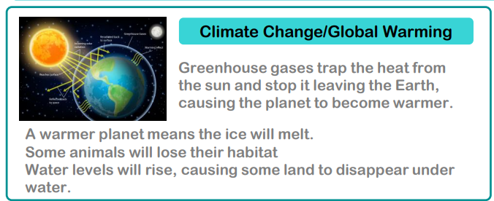
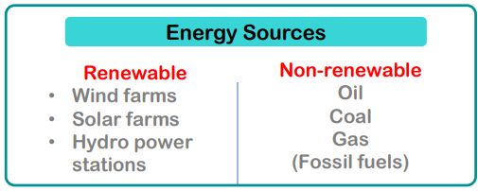
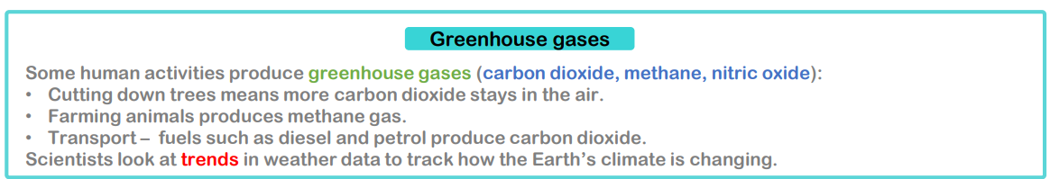
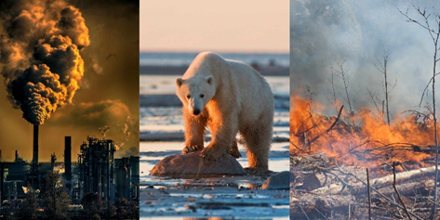


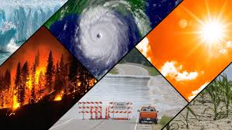
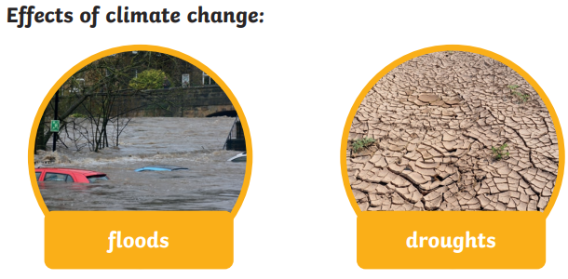

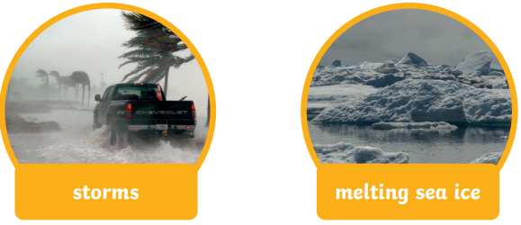
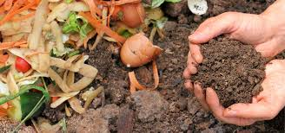
Science Knowledge Organiser-Looking After Our Environment –Year 6 Unit
Curiosity:
I can ask and answer questions about climate change.
I can research and identify impacts of climate change.
I understand what COP is and what they want to do.
Investigation:
I can investigate and identify ways to reduce landfill.
I can investigate ways to reduce fuel consumption.
I can investigate and compare data about weather.
I can investigate and identify ways to reduce energy consumption.
Explanation:
I can explain the causes and impacts of climate change.
I can explain ways to reduce fuel consumption and its impact on the climate.

