Slide 1
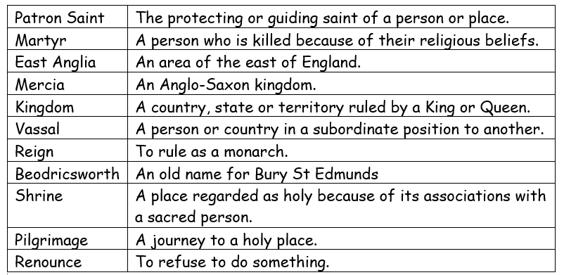
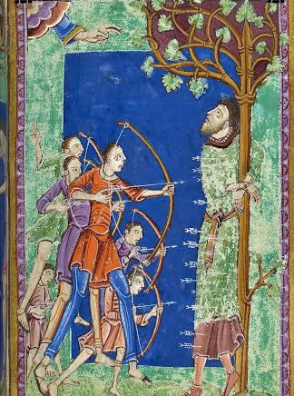
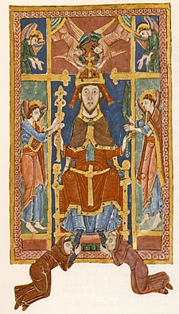
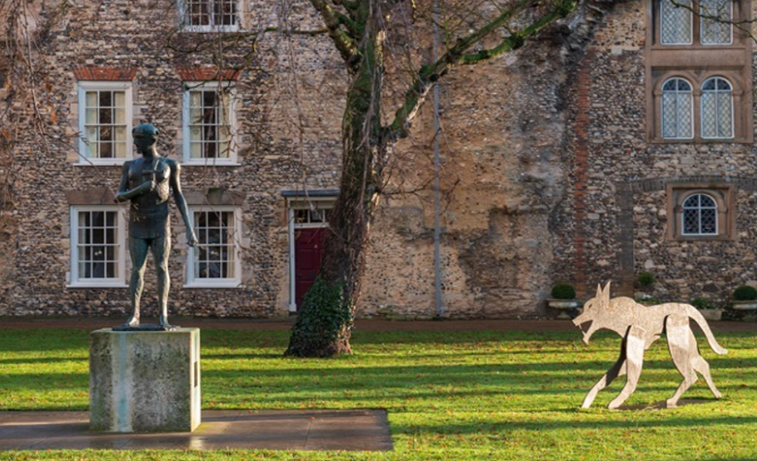
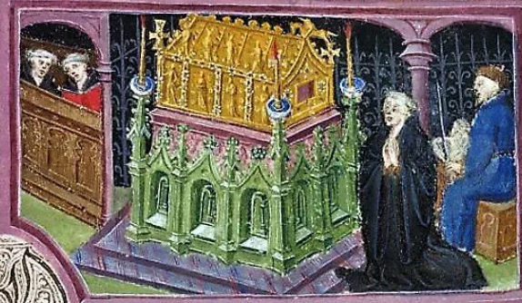
History Knowledge Organiser- Saint Edmund-
Who was Saint Edmund and how is he linked to our local area?
Chronology:
I can relate the rule of Saint Edmund in the chronological order with the Kings of East Anglia.
I can compare Saint Edmund’s rule to rulers from other periods that I have learnt about.
Equality:
I can explore how Saint Edmund became the King of East Anglia at such a young age and how he chose to rule.
I can compare the battle tactics of Viking leader Hingwar and the Anglo-Saxon King Edmund and use this to decipher why the Vikings won the battle at Hoxne.
I can investigate evidence of Saint Edmund in my local area.
I can explain how King Edmund refused to renounce his Christian Faith.
Change:
I can explore despite the Vikings destroying evidence of St Edmunds’ reign that we still know of his existence.
I can explain how the theories of how Edmund died changed over time.

