Slide 1
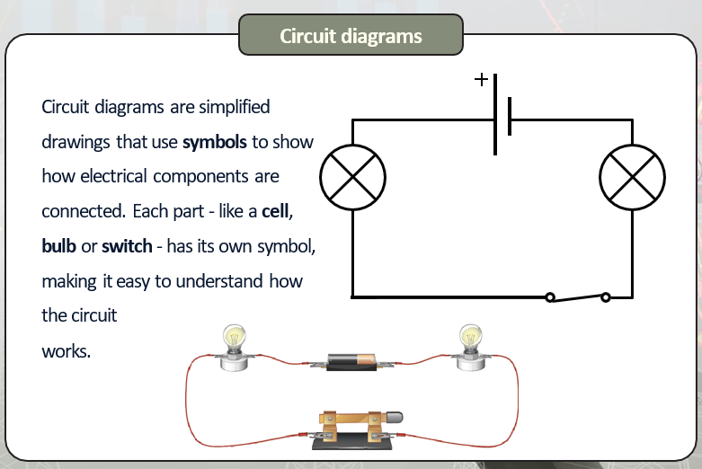
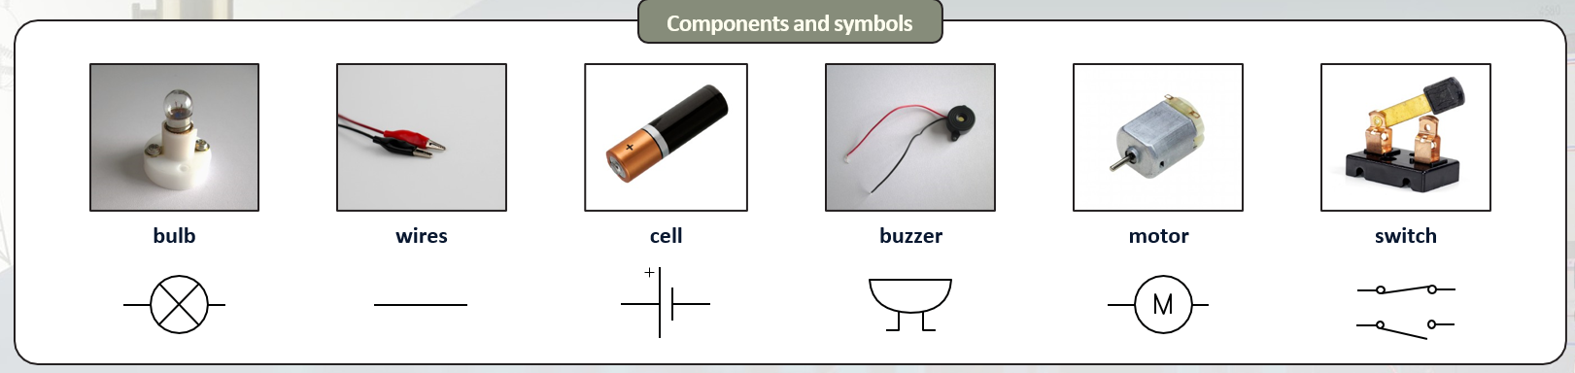
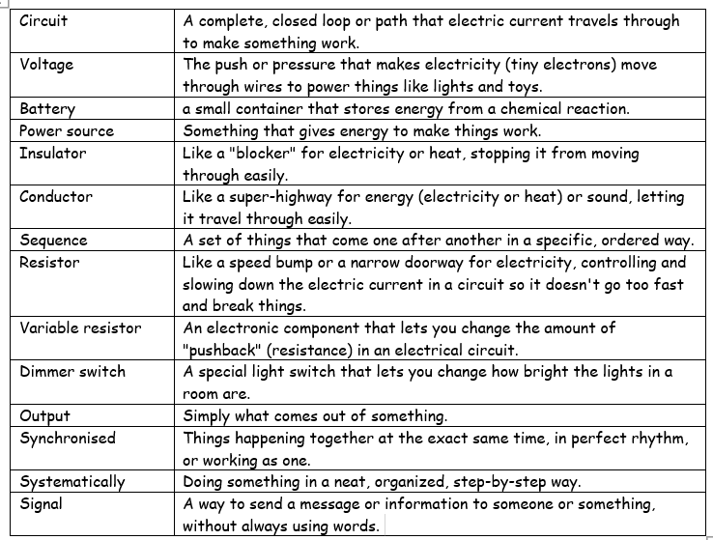
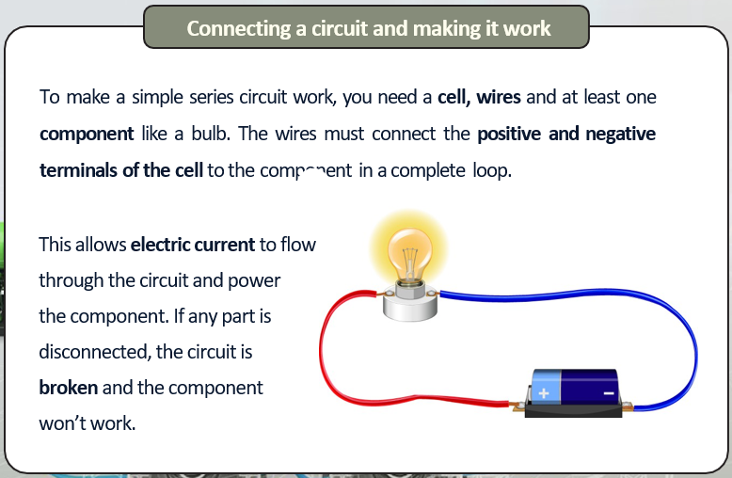
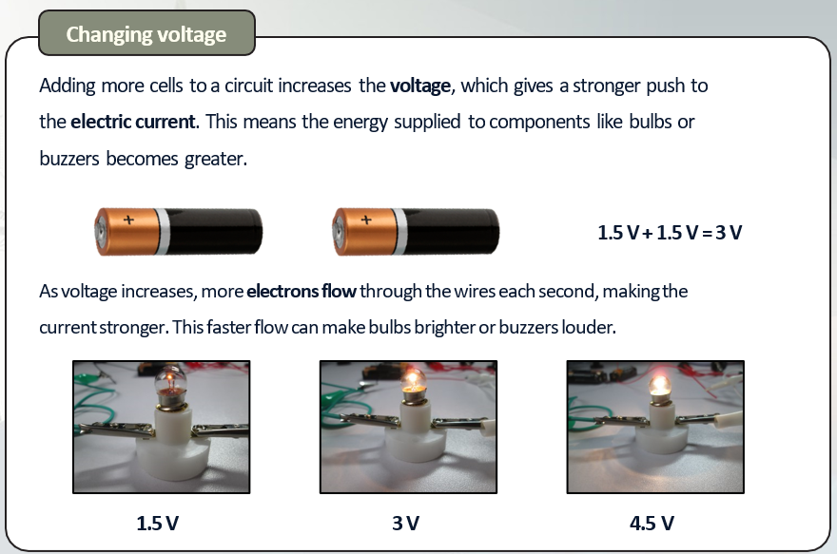
Science Knowledge Organiser –Electricity – Year 6 Unit
Curiosity:
I can explore voltage and its effect on an electrical circuit.
I can identify and explore how to solve problems in a circuit.
Investigation:
I can investigate and describe each part of an electrical circuit.
I can investigate what effects output of a circuit.
Explanation:
I can explain how to build a set of traffic lights using my knowledge of electrical circuits.
I can explain how to solve problems with electrical circuits.

