Slide 1
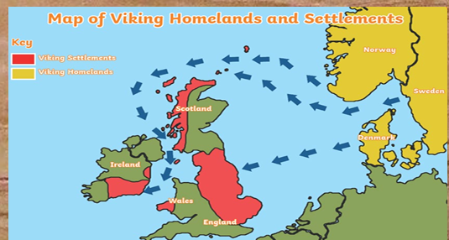
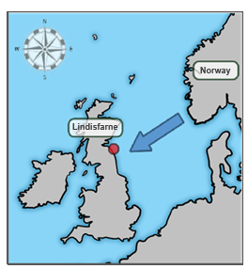
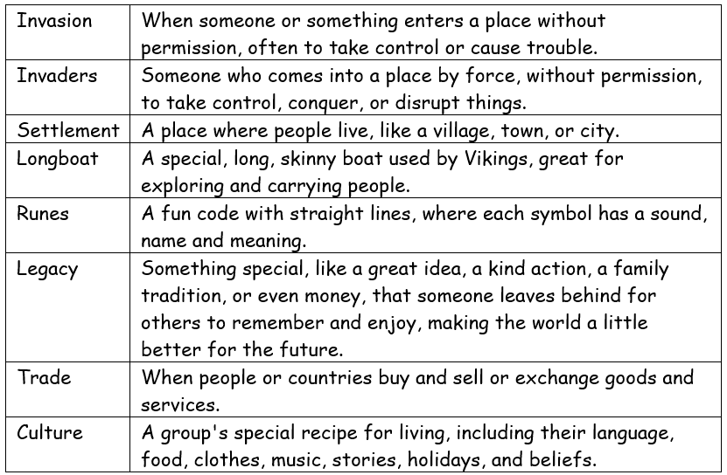
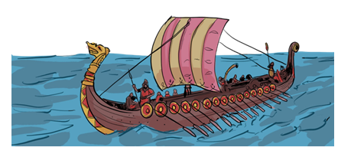
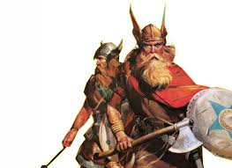
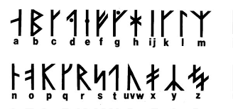
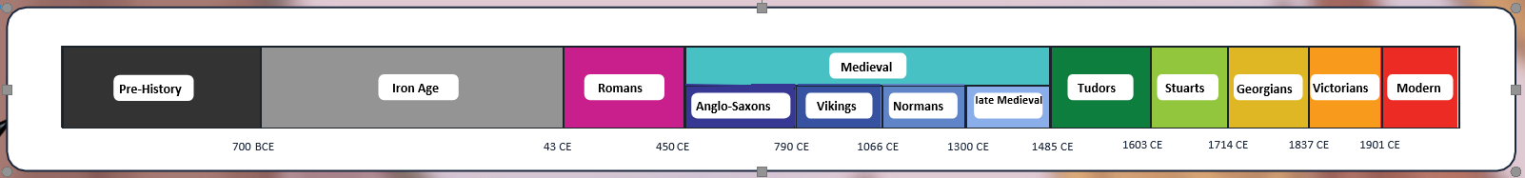
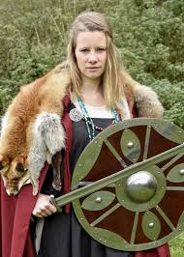
History Knowledge Organiser- Vikings
What impact did the Viking’s invasion have on British life?
Chronology:
I can relate the Viking period in chronological order and in relation to other historical periods I have studied, both Ancient and in more recent history.
I can place key events in the Viking conquest on a timeline.
I can study Viking artefacts and estimate when they were used on a timeline, explaining the reasons for the positions in time.
Equality:
I can explore the positions of men and women in Viking Society.
I can compare their roles.
I can compare the ambitions for the Vikings and Anglo Saxons in their struggle for the Kingdom of England.
Change:
I can explain the impact of Viking invasion on British life.
I can identify some of the changes that took place that impact on life now.
I can explain why the Vikings left their countries of origin.
I can explain the impact of Viking runes and transport.

