Slide 1
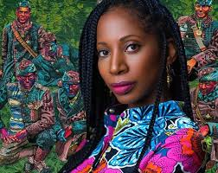
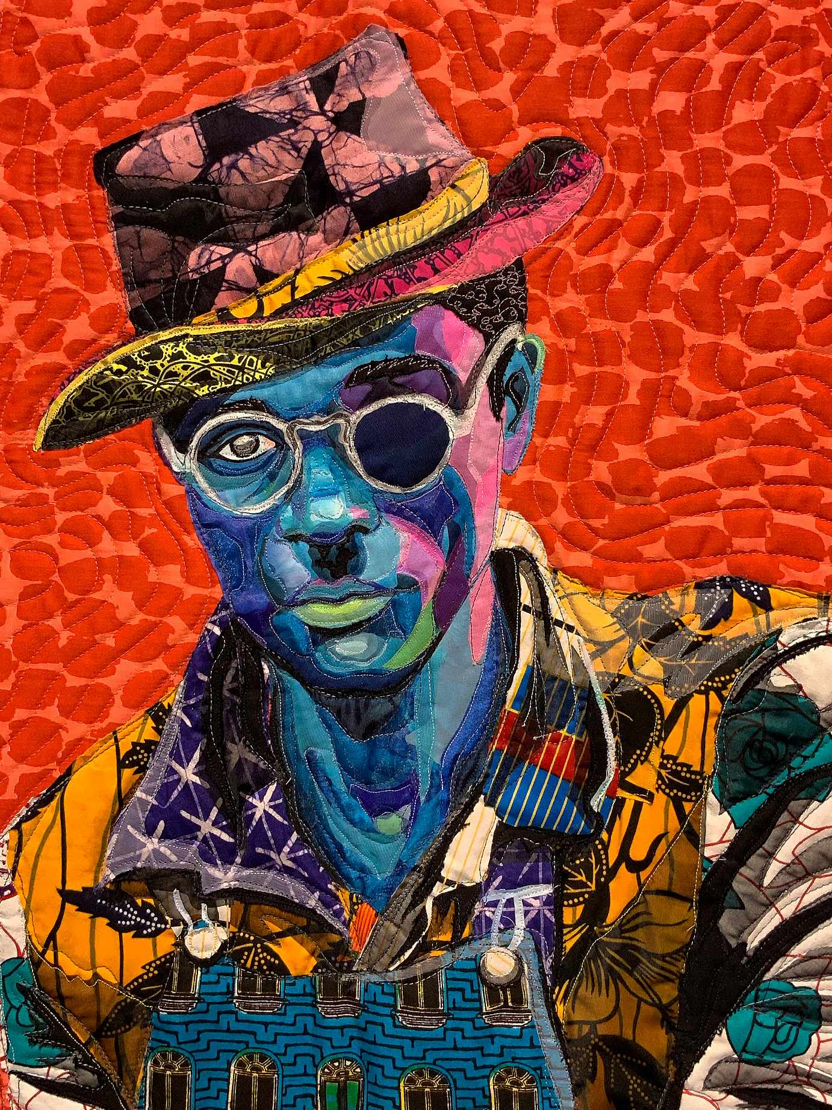
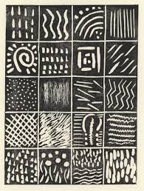
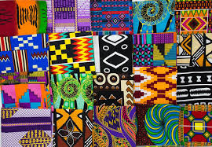
LKS2 Knowledge Organiser: Art –Printing
Three big ideas Inspiration I can study and discuss a range of African prints I can describe the colours and pattern forms in the prints I can study and discuss how Bisa Butler uses African prints in her work Experimentation I can identify shapes and patterns in designs I can explore how to print using shaped blocks I can print on different surfaces I can investigate how to make African style patterns using blocks Expression I can produce a printing block I can use it to print on a range of surfaces I can identify, create and print with a range of colours I know how to create African style printed patterns | Vocabulary
Explore | Design | African prints | Textiles | Scratching | Pressure
Process | Adapt | Modify | Press | Print | Indented
Starting point | Firmly | Transfer | Transpose | Block print | Repeat
Seal | Rotate | Pressure | Reverse
Bisa Butler 1973 - present
Three Kings

